Slide 2
Together, listening to the Holy Spirit, let us be led by God
Adsumus, Sancte Spiritus
We stand before You, Holy Spirit, as we gather together in Your name.
With You alone to guide us, make
Yourself at home in our hearts;
Teach us the way we must go
and how we are to pursue it.
We are weak and sinful;
do not let us promote disorder. Do not let ignorance
lead us down the wrong path
nor partiality influence our actions.
Let us find in You our unity
so that we may journey together
to eternal life and not stray from the way of truth and what is right.
All this we ask of You, who are at work in every place and time, in the communion of the Father and the Son, forever and ever. Amen.
Prayer for the invocation of the Holy Spirit, attributed to
Saint Isidore of Seville (560 – 636)

Slide 3
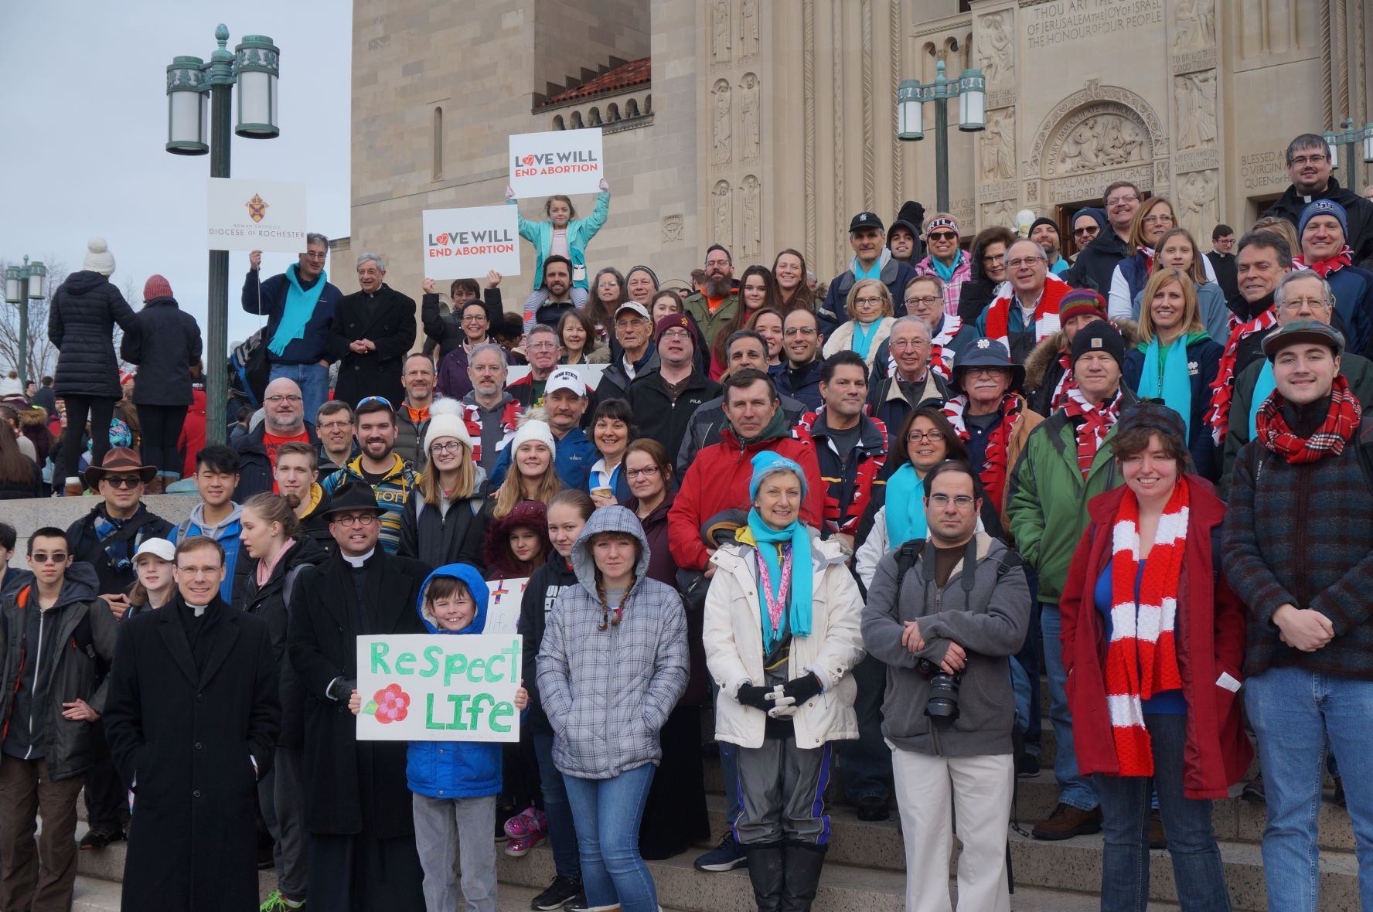
“Synodality is the way of being the Church today according to the will of God, in a dynamic of discerning and listening together to the voice of the Holy Spirit.”
Pope Francis

Slide 4
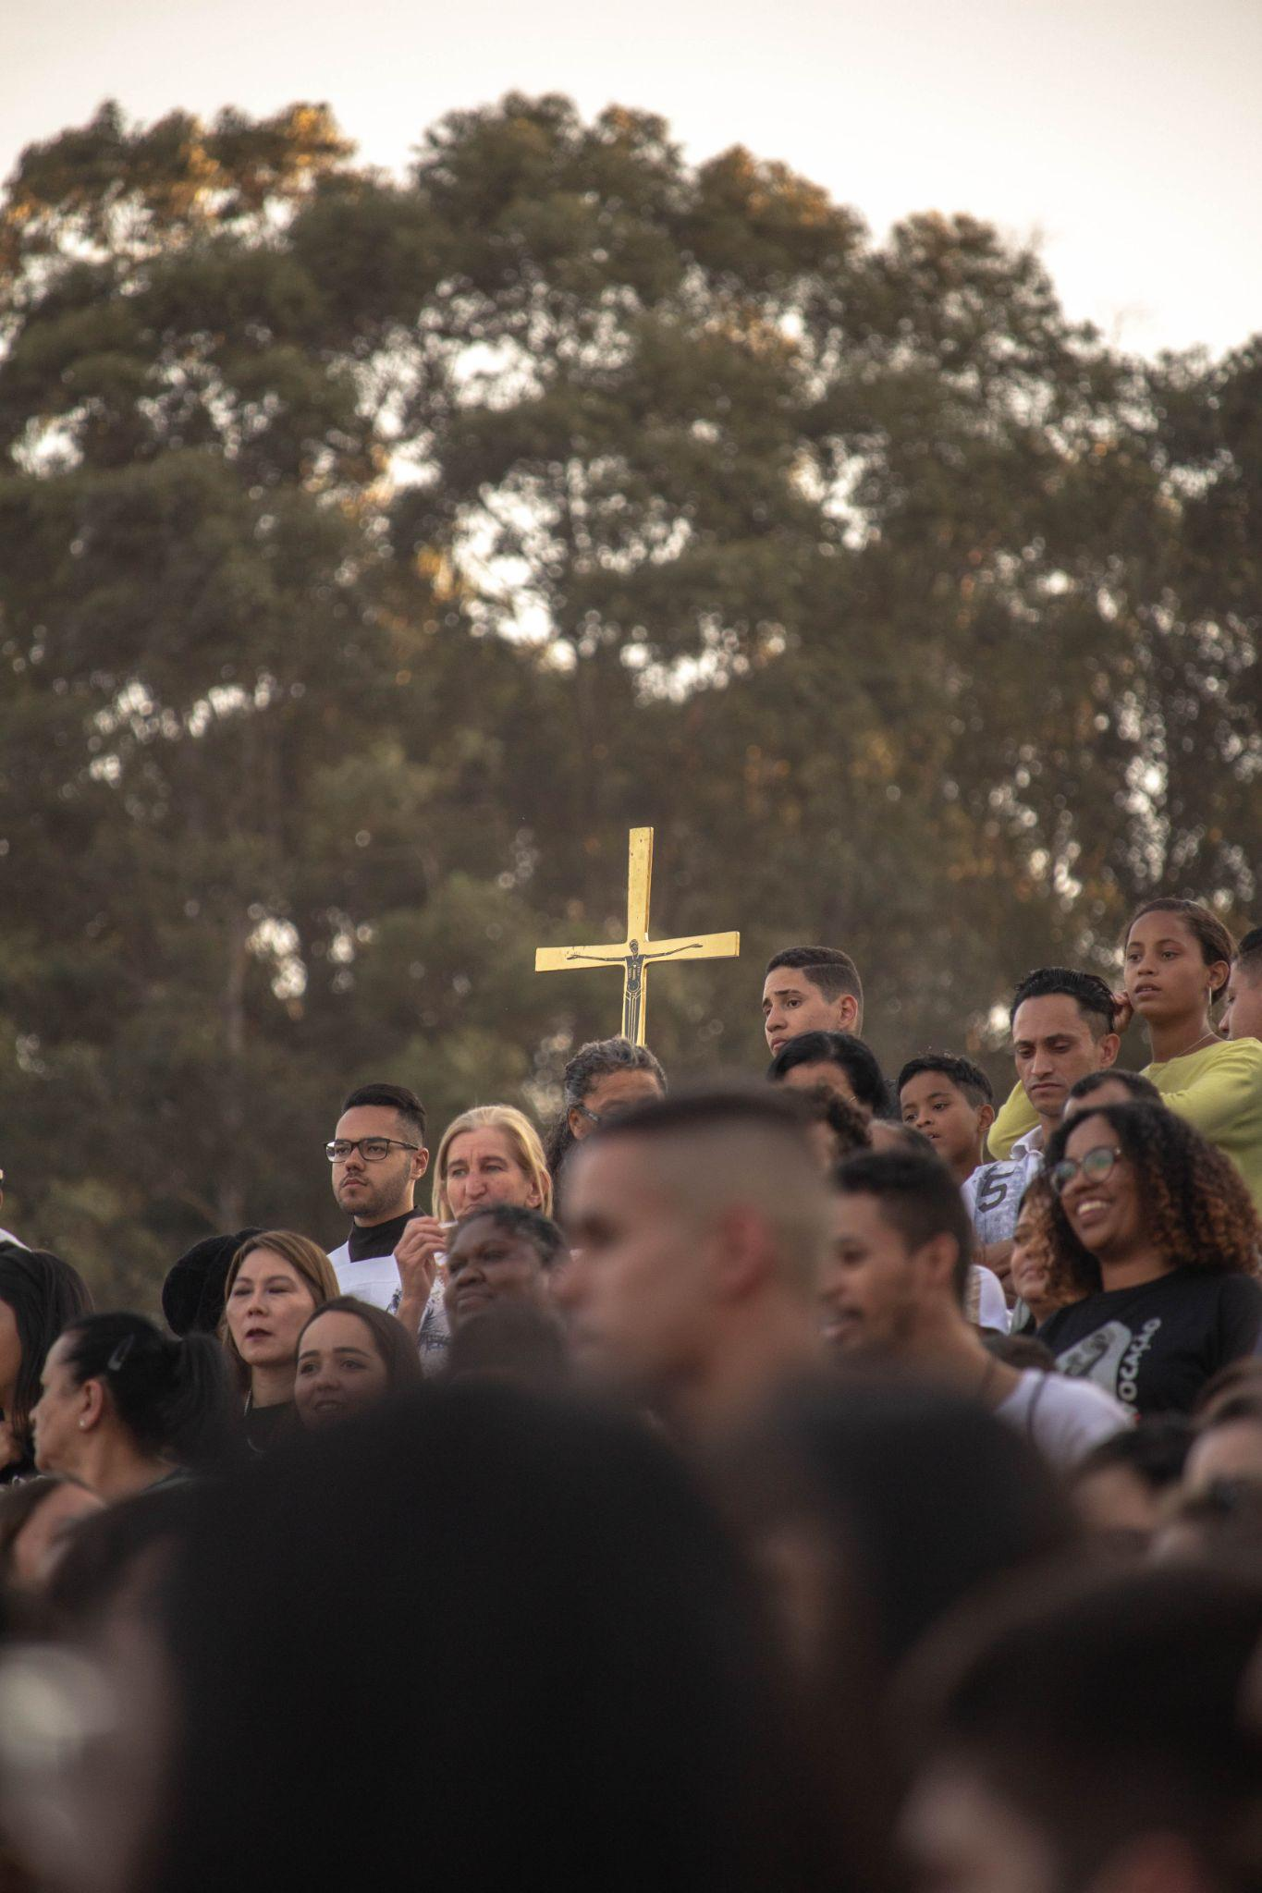
Listening to the Scriptures
Jesus, the Crowd, and the Apostles
“Essentially, three actors (plus one) are involved. The first, of course, is Jesus, the
absolute protagonist who takes the initiative, sowing the words and signs of the coming of the Kingdom without “showing partiality” (cf. Acts 10:34).”
“The work of evangelization and the message of salvation would not be comprehensible without Jesus’ constant openness to the widest possible audience, which the Gospels refer to as the crowd, that is, all the people who follow him along the path, and at times even pursue him in the hope of a sign and a word of salvation: this is the second actor on the scene of Revelation. The proclamation of the Gospel is not addressed only to an enlightened or chosen few.”
“Among those who follow Jesus, the figure of the apostles, whom he himself calls from the beginning, having given them the task of mediating authoritatively the crowd’s relationship with Revelation and with the coming of God’s Kingdom, clearly becomes prominent. The third actor’s entrance on the scene occurs not thanks to a cure or a conversion, but because it coincides with Jesus’ call. The election of the apostles is not the privilege of an exclusive position of power and separation but the grace of an inclusive ministry of blessing and fellowship. Thanks to the gift of the Spirit of the Risen Lord, they are to guard the place of Jesus, without replacing him: not to put filters on his presence, but to make it easy to encounter him.” (PD, 17 - 19)
In order for the Church to be herself, and for her mission to bear fruit, all three must always be present: Jesus, the crowd, and the apostles!

Slide 5
The Challenge of Synodality
“What the Lord is asking of us is already in some sense present in the very word “Synod.” Journeying together – laity, pastors, the Bishop of Rome – is an easy concept to put into words, but not so easy to put into practice.”
Pope Francis, Address at the Ceremony Commemorating the 50th Anniversary
of the Institution of the Synod of Bishops,
October 17, 2015

Slide 6
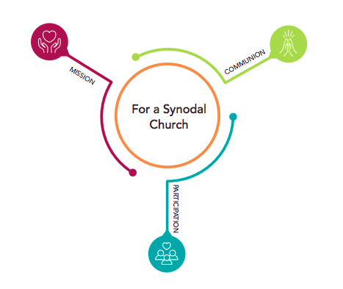
Communion: God gathers us together as diverse peoples of one faith, through the covenant of love that he offers to his people. The communion we share is deeply rooted in that love and the unity of the Trinity.
Participation: A call for the involvement of all who belong to the People of God – laity, consecrated and ordained – to engage in the exercise of deep and respectful listening to one another. This listening creates space for us to hear the Holy Spirit together and guides our aspirations for the Church of the Third Millennium.
Mission: Our mission is to witness to the love of God in the midst of the whole human family. This Synodal Process has a deeply missionary dimension to it. It is intended to enable the Church to better witness to the Gospel, especially with those who live on the spiritual, social, economic, political, geographical, and existential peripheries of our world. In this way, synodality is a path by which the Church can more fruitfully fulfill her mission of evangelization in the world, as a leaven at the service of the coming of God’s kingdom.
Adapted from the Vademcum for the Synod, 1.1—1.4

Slide 7
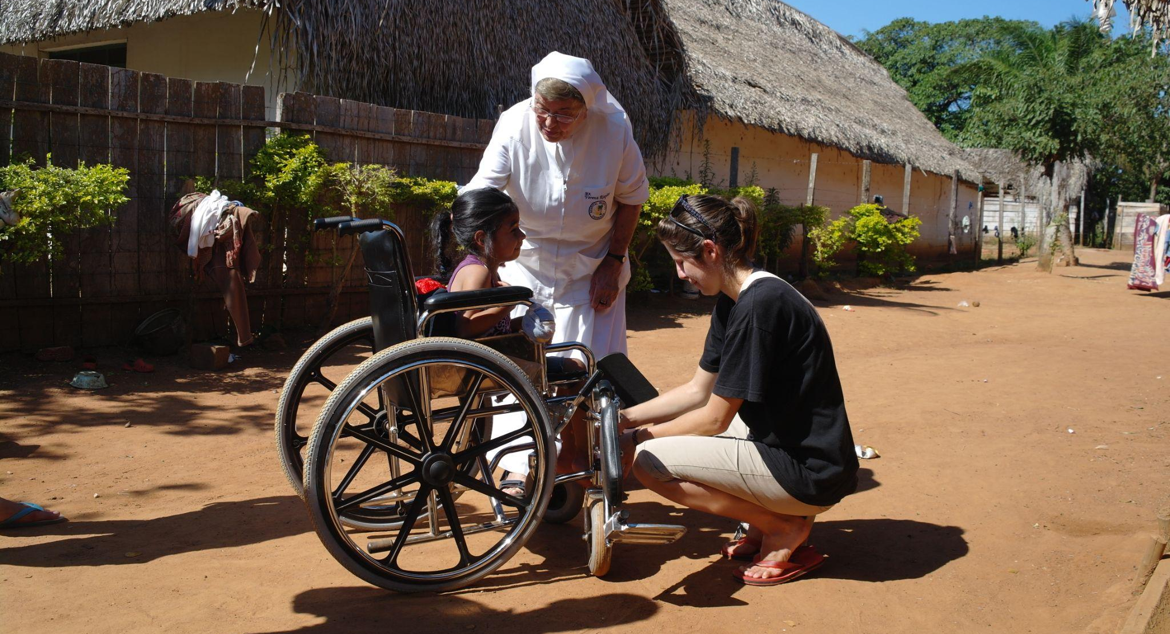
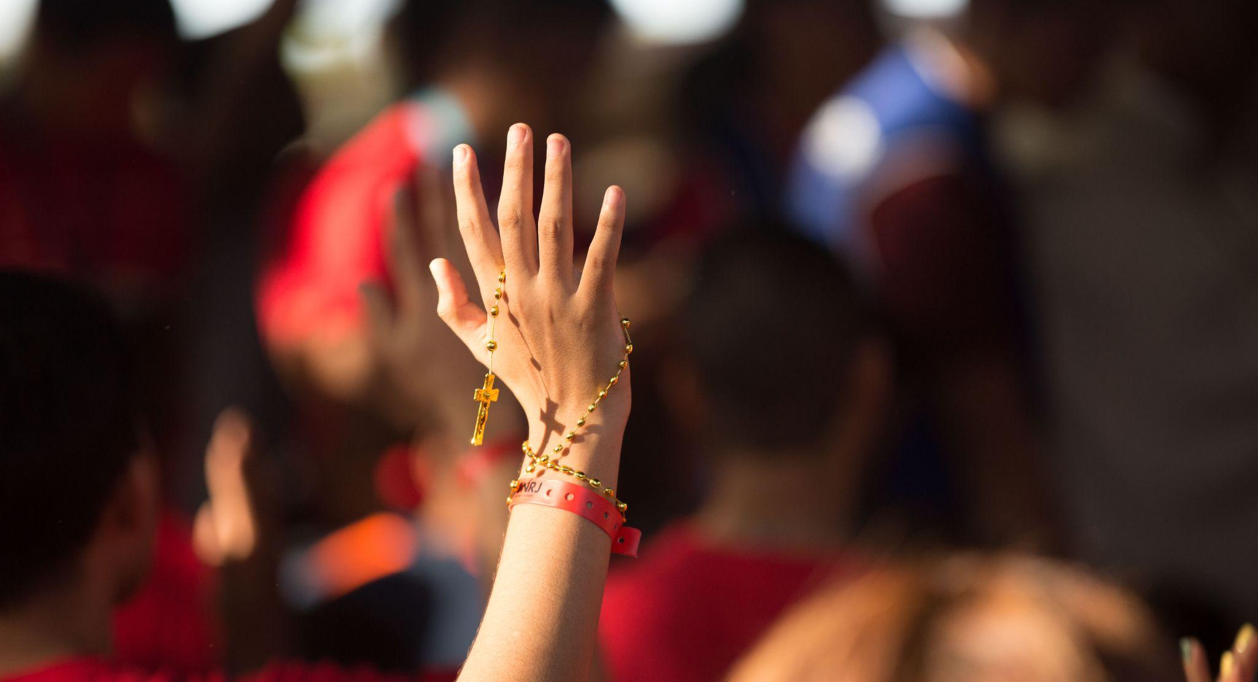
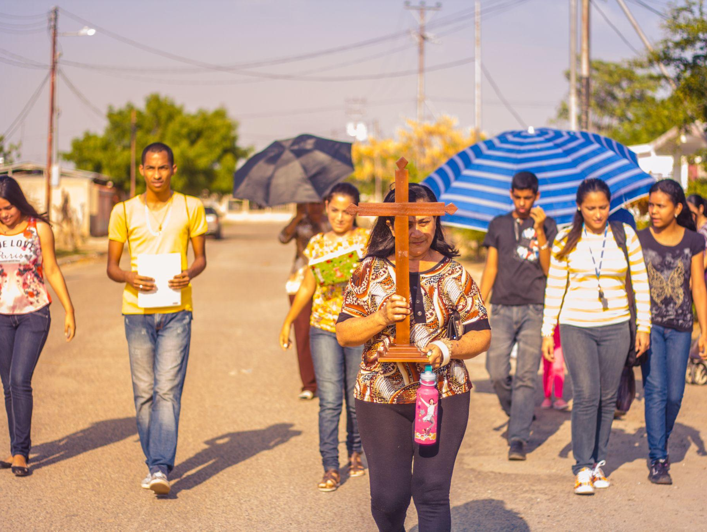
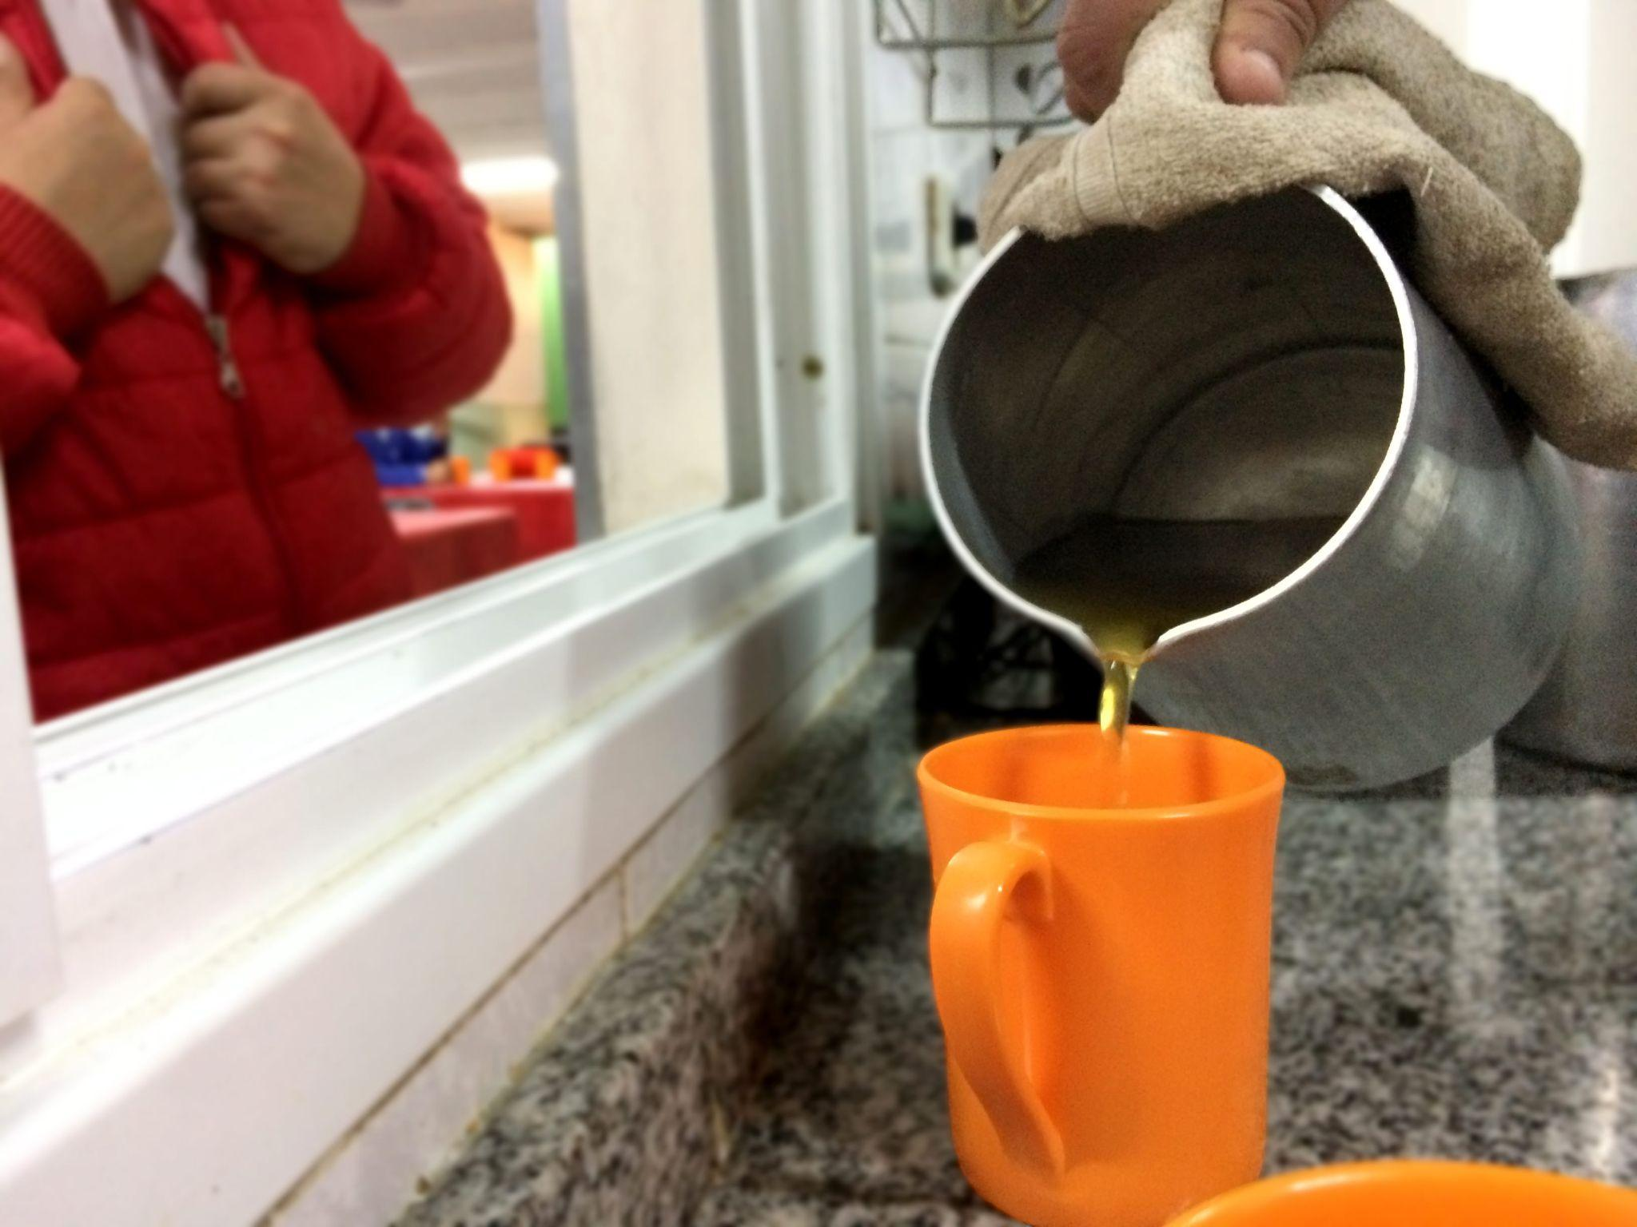
Key convictions for a Synodal Church
Listen to one another can be an authentic experience of discerning the Holy Spirit
In a spirit of meditation, grounded in the liturgy, Sacred Scripture, and prayer
An experience shared with one another, not just filling out a questionnaire
A process, not a one-time event
This journey unites us more deeply to one another, and sends us out on mission to others
(Vademecum 1.1)

Slide 8
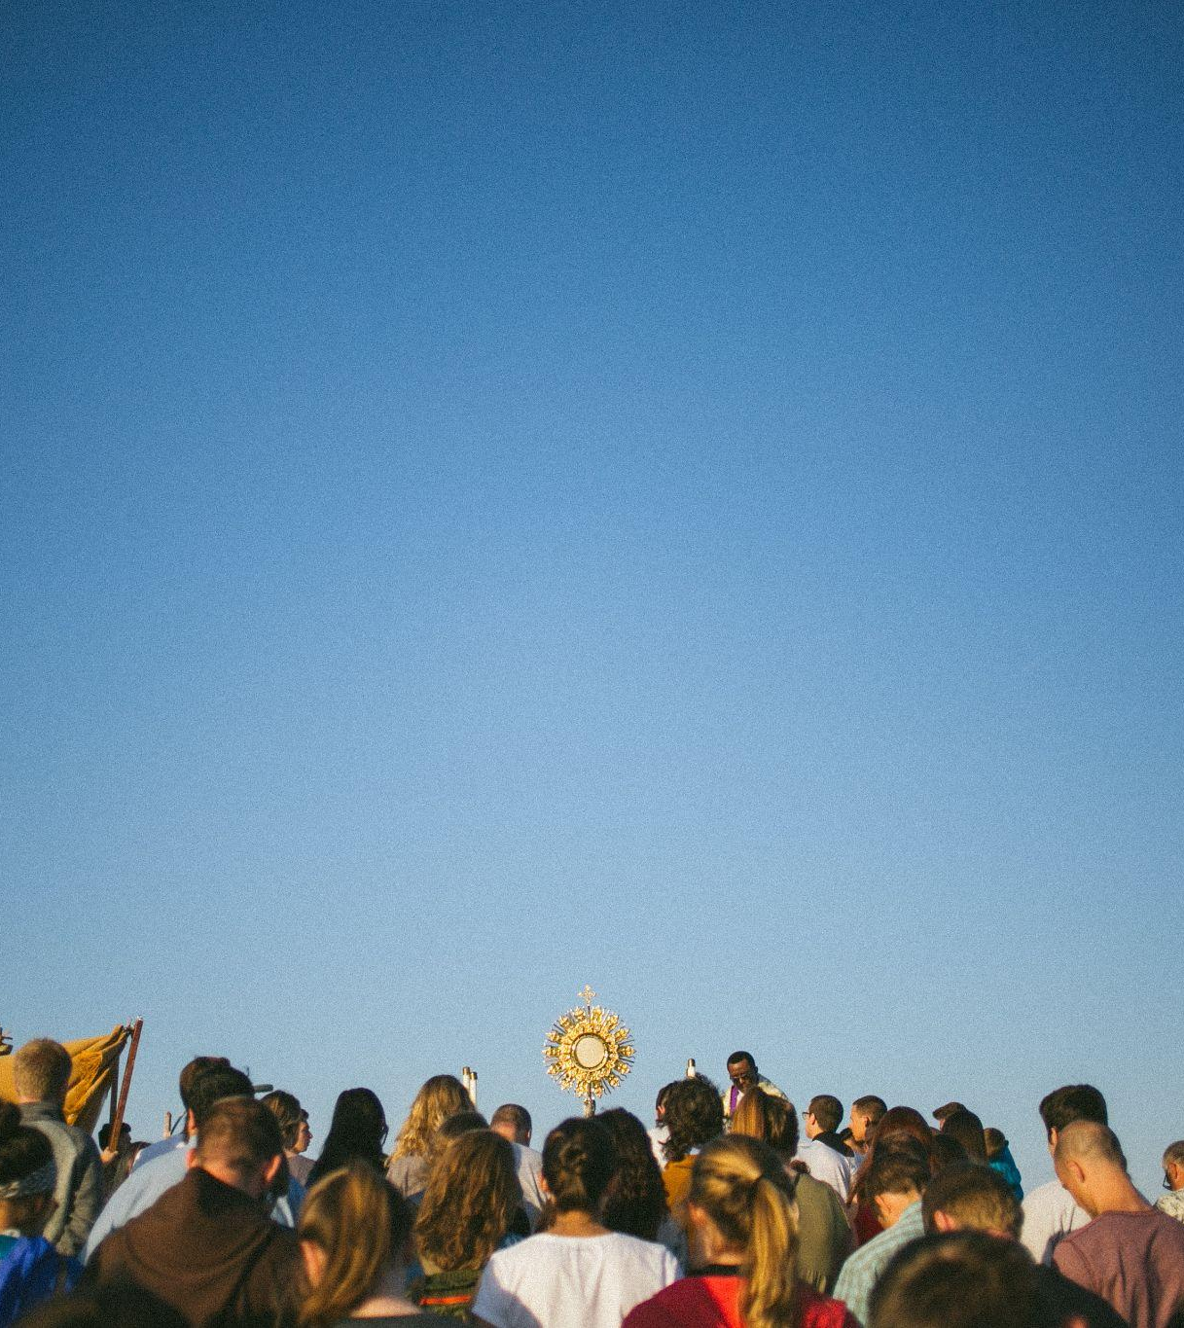
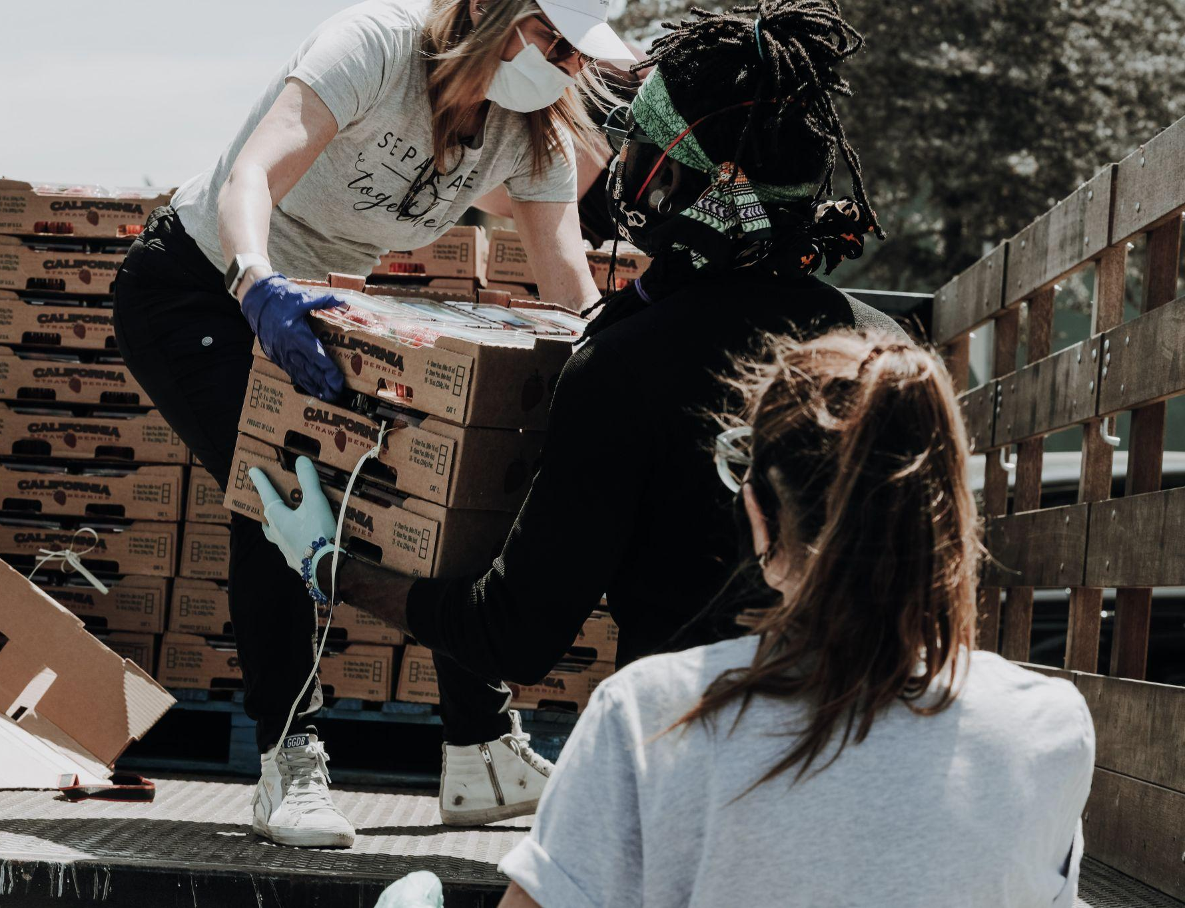
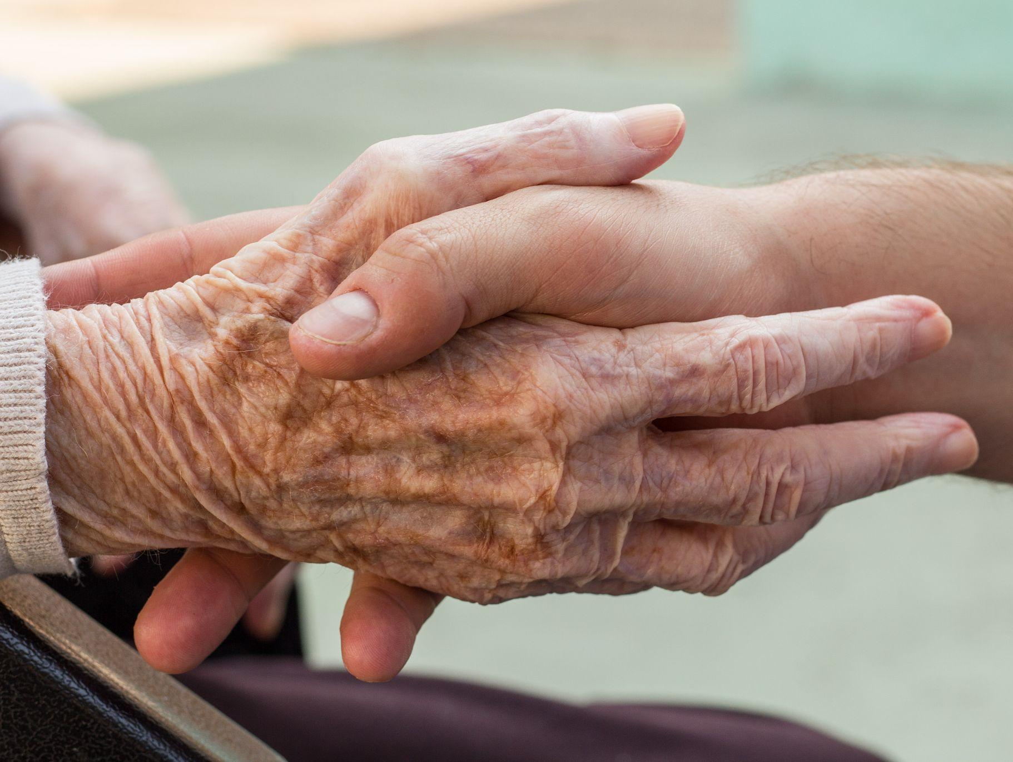
“The purpose of the Synod, and therefore of this consultation, is not to produce documents, but “to plant dreams, draw forth prophecies and visions, allow hope to be nourished, inspire trust, bind up wounds, weave together relationships, awaken a dawn of hope, learn from one another, and create a bright resourcefulness that will enlighten minds, warm hearts, give strength to our hands.” (PD, 32)

Slide 9
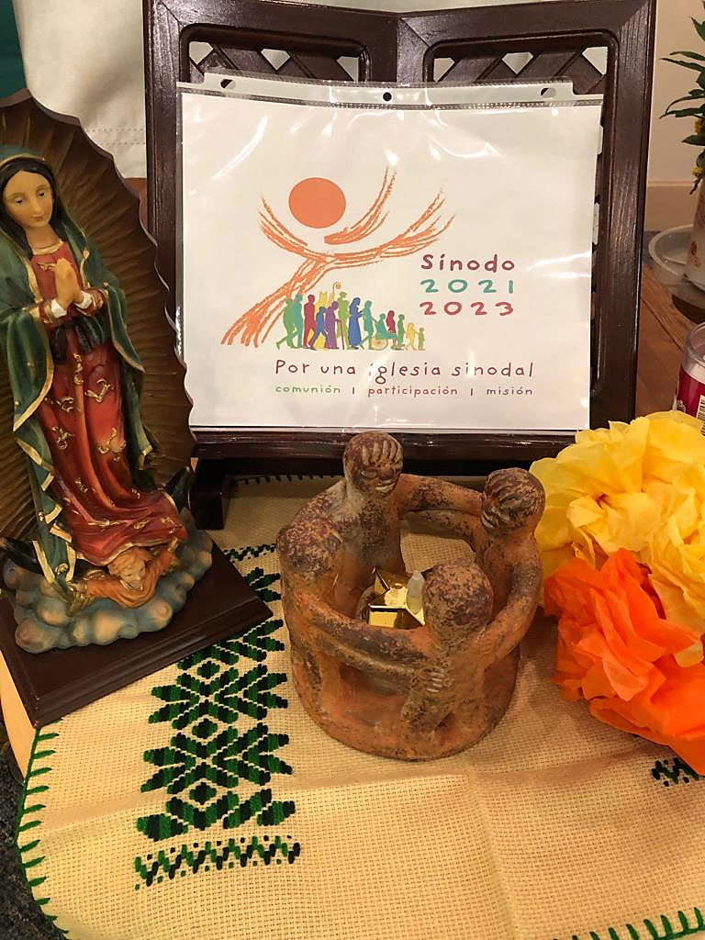
Basic Question of the Synodal Process
A basic question prompts and guides us: How does this “journeying together,” which takes place today on different levels (from the local level to the universal one), allow the Church to proclaim the Gospel in accordance with the mission entrusted to her; and what steps does the Spirit invite us to take in order to grow as a synodal Church?
(PD, 2)
The fundamental question for the consultation of the People of God
A synodal Church, in announcing the Gospel, “journeys together:” How is this “journeying together” happening today in your local Church? What steps does the Spirit invite us to take in order to grow in our “journeying together”?
(PD, 26)

Slide 10
Ten Themes to Explore
COMPANIONS ON THE JOURNEY: In the Church and in society, we are side by side on the same road. The Preparatory Document offers the reflection that Jesus is the protagonist of the Church and its people, who proclaims to the crowd; with those called to be apostles and their successors serving in unity and fidelity. The Synodal process ultimately should reveal more fully who Christ is and how he informs the Church. (PD, 18-19)
LISTENING: Listening is the first step, but it requires having an open mind and heart, without prejudices.
SPEAKING OUT: All are invited to speak with courage and parrhesia (candidly), that is, integrating freedom, truth, and charity.
CELEBRATION: “Journeying together” is only possible if it is based in prayer, and on a communal listening to the Word of God and the celebration of the Eucharist.
SHARING RESPONSIBILITY FOR OUR COMMON MISSION: Synodality is at the service of the mission of the Church, in which all members are called to participate.
DIALOGUE IN CHURCH AND SOCIETY: Dialogue is a path of perseverance that also includes silences and sufferings, but which is capable of gathering the experience of persons and peoples.
ECUMENISM: The dialogue between Christians of different denominations, united by one Baptism, has a special place in the synodal journey.
AUTHORITY AND PARTICIPATION: A synodal Church is a participatory and co-responsible Church.
DISCERNING AND DECIDING: In a synodal style, decisions are made through discernment, based on a consensus that flows from the common obedience to the Spirit.
FORMING OURSELVES IN SYNODALITY: The spirituality of journeying together is called to become an educational principle for the formation of the human person and of the Christian, of the families, and of the communities.

Slide 11
For a Synodal Church: Communion / Participation / Mission
Diocesan Synodal Timeline
October 2021 – November 15, 2021
Mid November 2021 – March 31, 2022
April 1, 2022 –
June 30, 2022
Moving Forward
Review/study documents and materials for the process
Appoint Synod Diocesan Delegates: Bernard Grizard and Dr. Shannon Kilbridge
Diocesan Opening Mass with Bishop Matano on October 10, 2021 at Sacred Heart Cathedral
Launch diocesan Synod webpage and Bishop Matano’s introduction video: www.dor.org/synod
Meet with Deans and Presbyteral Council
Orientation for Facilitators Team
Synodal gatherings occur throughout the Diocese of Rochester
Invite parishes to continue praying for the Synod using available prayer resources
Ongoing updates and resources posted on DOR Synod webpage and social media regarding progress
Upon completion of gatherings the facilitators submit the input generated at the gatherings online by March 31, 2022
Gather and compile the submitted Diocesan input
Prepare Diocesan Synthesis Report
DOR sends Diocesan Synthesis report to the USCCB by June 30, 2022
More to come for period of “waiting” before the Synod of Bishops in October 2023
CONTINUE PRAYING…..
September 2022 – March 2023
CONTINENTAL PHASE: USCCB gathers all reports from across the country to create a synthesis to send to the Vatican
March 2023 – October 2023
Vatican gathers all the reports from bishop conferences around the world to create a working document for the Synod of Bishops in Rome
October 2023
UNIVERSAL PHASE: The XVI Ordinary General Assembly of the Synod of Bishops from around the world in Rome

Slide 12
Thank you!

